Slide 1

Bringing the world’s creators together.

Slide 2
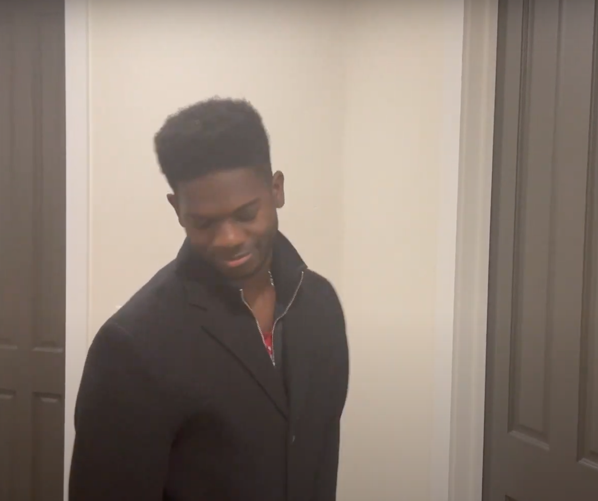
Our problem:
Small business owners have a hard time finding a physical space to work in or to sell their products in. These spaces are often too: expensive, large, or difficult to navigate as a single leasor.

Slide 3
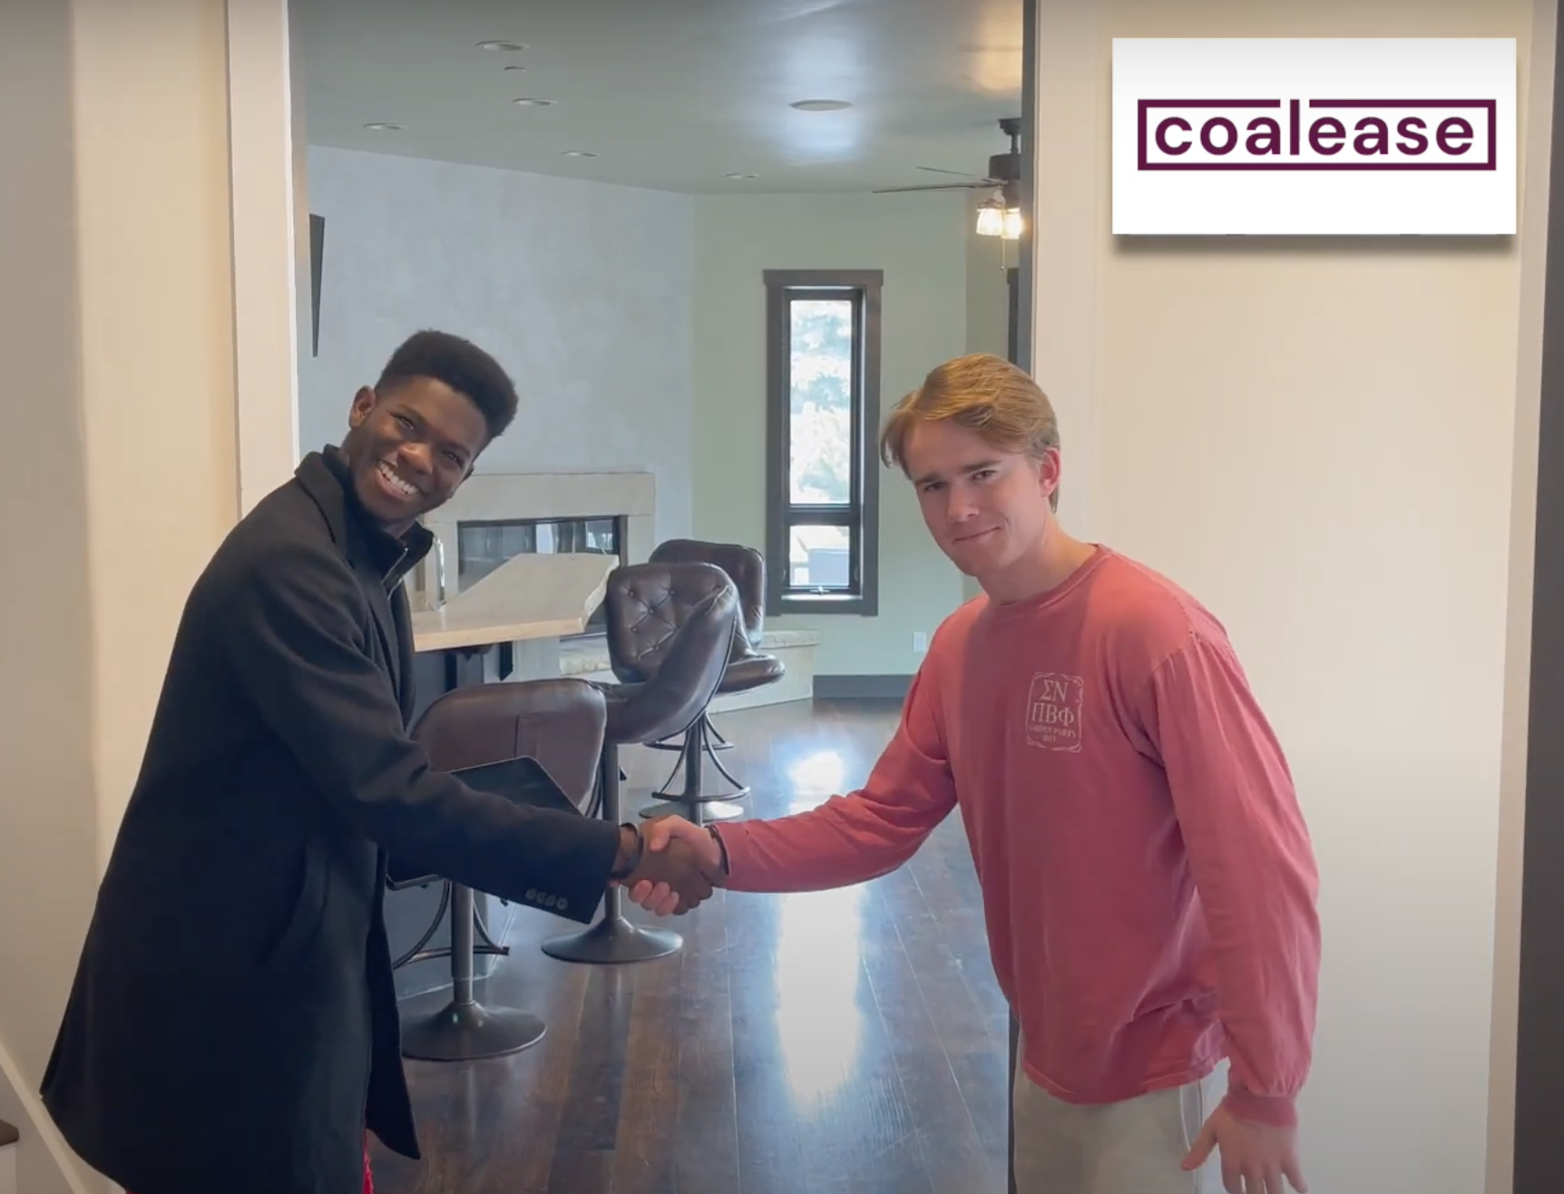
Our solution:
Bring creators together under one roof to lease together, complement each other’s products (synergize), and build a creative community.

Slide 4
Our tasks:
Simple
Find an affordable place to rent with another small creative businesses.
Moderate
Compare different leasing options to determine what space is best for you and your fellow creators together.
Complex
Navigate and finalize a leasing agreement along with the other creators sharing your space.

Slide 5
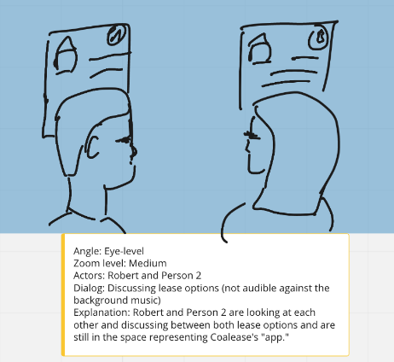
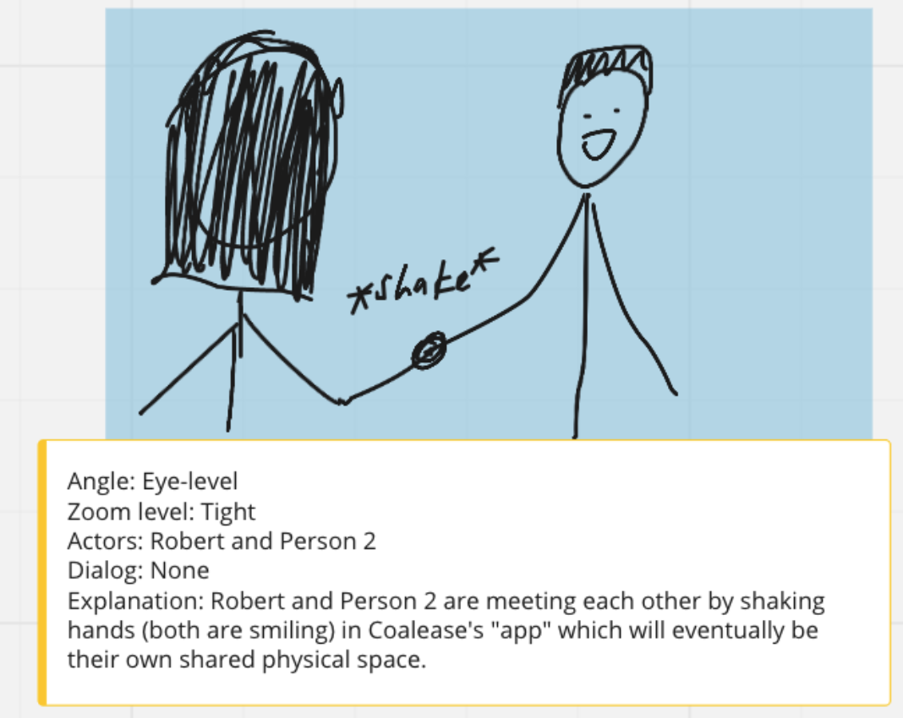
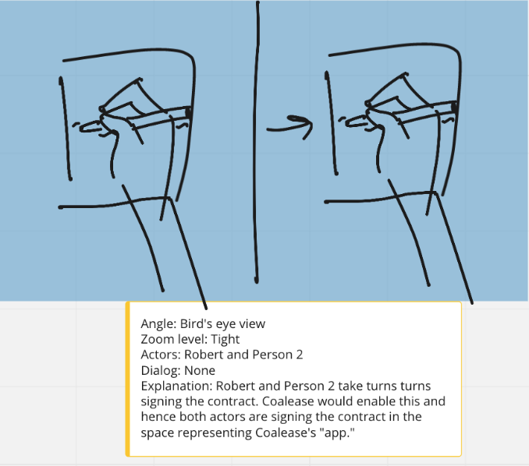
Storyboards
A sampling of scenes:
Full story board: https://miro.com/app/board/o9J_lWNqn9I=/
Notes:
https://miro.com/app/board/o9J_lWNqn9I=/

